Slide 1
Deep Learning
Transfer Learning

Slide 2
Problem to solve
MAMe: Museum Art Medium dataset
Image classification with 29 classes.
Expected final accuracy be higher than 71%

Slide 3
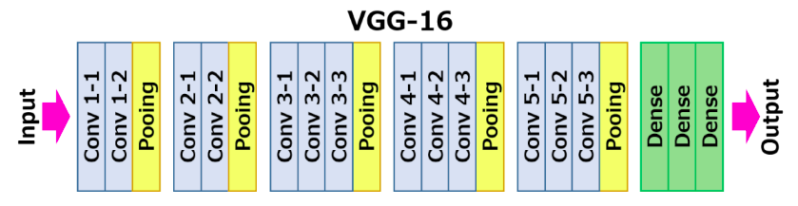
Pretrained model
For the pretraining the VGG16 model was used.
Early stopping: val_loss with patience=20
Saved weights: the best val_accuracy

Slide 4
Fine tuning

Slide 5
Initial architectures
Weights for first 13 layers were loaded.
3 different Dense layers architecture were tried.
Dense(512) -> Dropout(0.2) -> Dense(512) -> Dense(29)
BN -> Dense(512) + L2 -> Dropout(0.3) -> Dense(512) + L2 -> Dense(29)
BN -> Dense(256) + L2 -> Dropout(0.4) -> Dense(256) + L2 -> Dense(256) + L2 -> Dense(29)

Slide 6
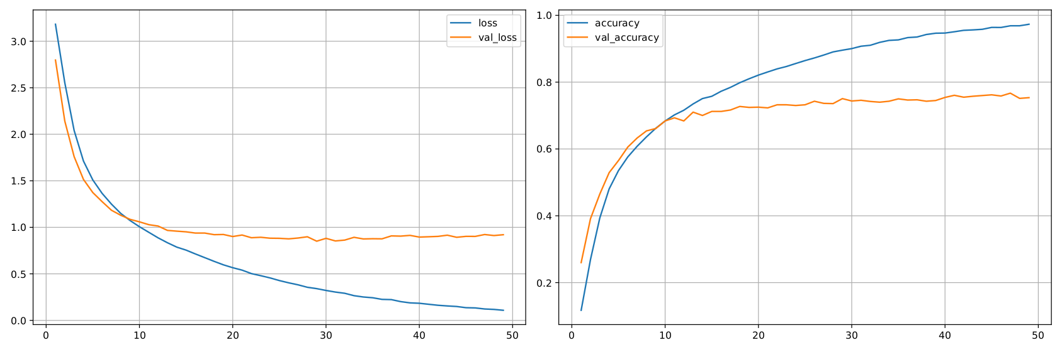
Results
i [Dense(512) -> Dropout(0.2) -> Dense(512) -> Dense(29)]
Loss: 0.1084; Accuracy: 97.33%;
Validation loss: 0.9205; Validation accuracy: 75.36%

Slide 7
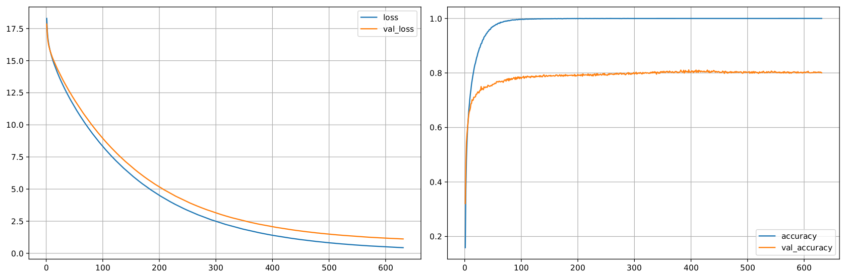
Results
ii [BN -> Dense(512) + L2 -> Dropout(0.3) -> Dense(512) + L2 -> Dense(29)]
Loss: 0.4393; Accuracy: 99.99%;
Validation loss: 1.1183; Validation accuracy: 80.04%

Slide 8
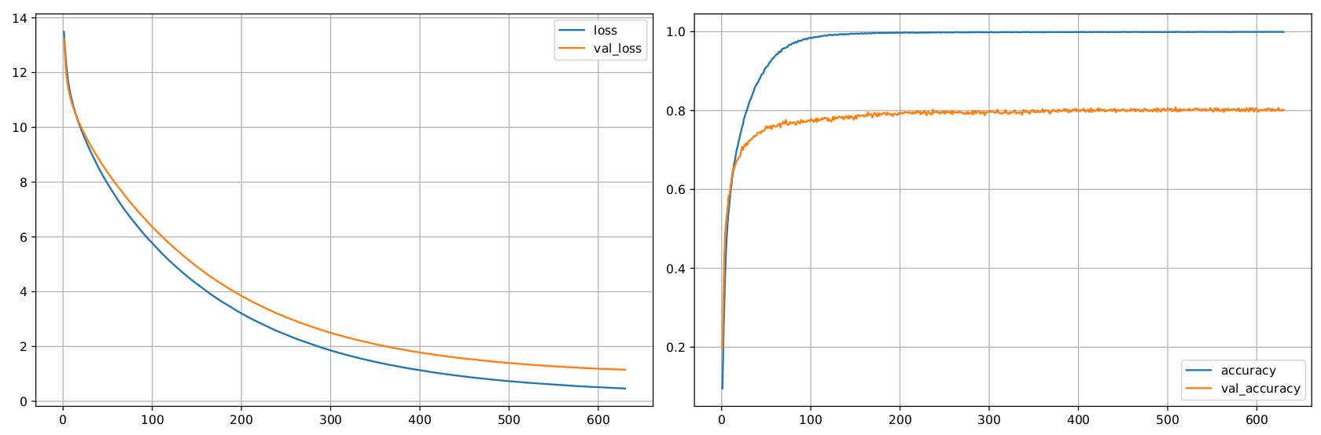
Results
iii [BN -> Dense(256) + L2 -> Dropout(0.4) -> Dense(256) + L2 -> Dense(256) + L2 -> Dense(29)]
Loss: 0.4676; Accuracy: 99.94%;
Validation loss: 1.1532; Validation accuracy: 80.18%

Slide 9
The third architecture was chosen
Experiment was repeated with longer time on cluster to reach the early stopping moment.
The same experiment was runned with data augmentation:
rotation_range=20,
width_shift_range=0.2,
height_shift_range=0.2,
horizontal_flip=True,
zoom_range=0.2

Slide 10
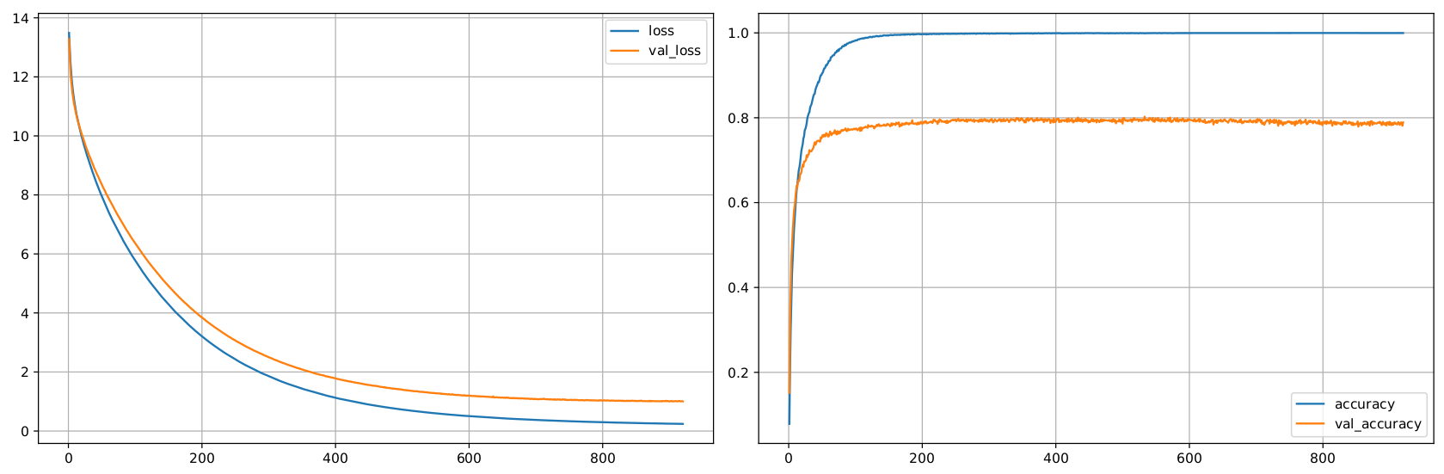
Results
i Loss: 0.6381; Accuracy: 99.92%;
Validation loss: 1.3175; Validation accuracy: 80.03%

Slide 11
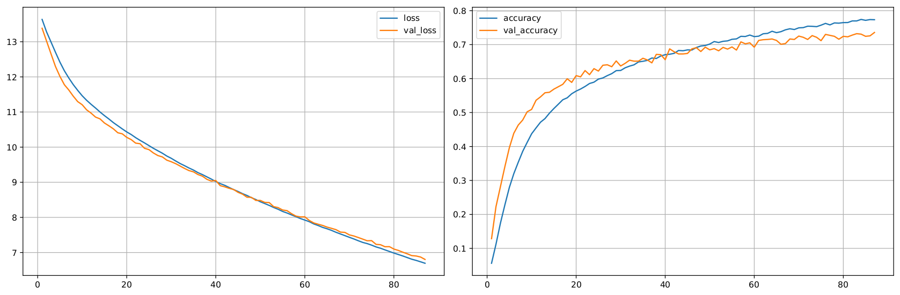
Results
ii Loss: 6.6944; Accuracy: 77.33%;
Validation loss: 6.8026; Validation accuracy: 73.58%

Slide 12
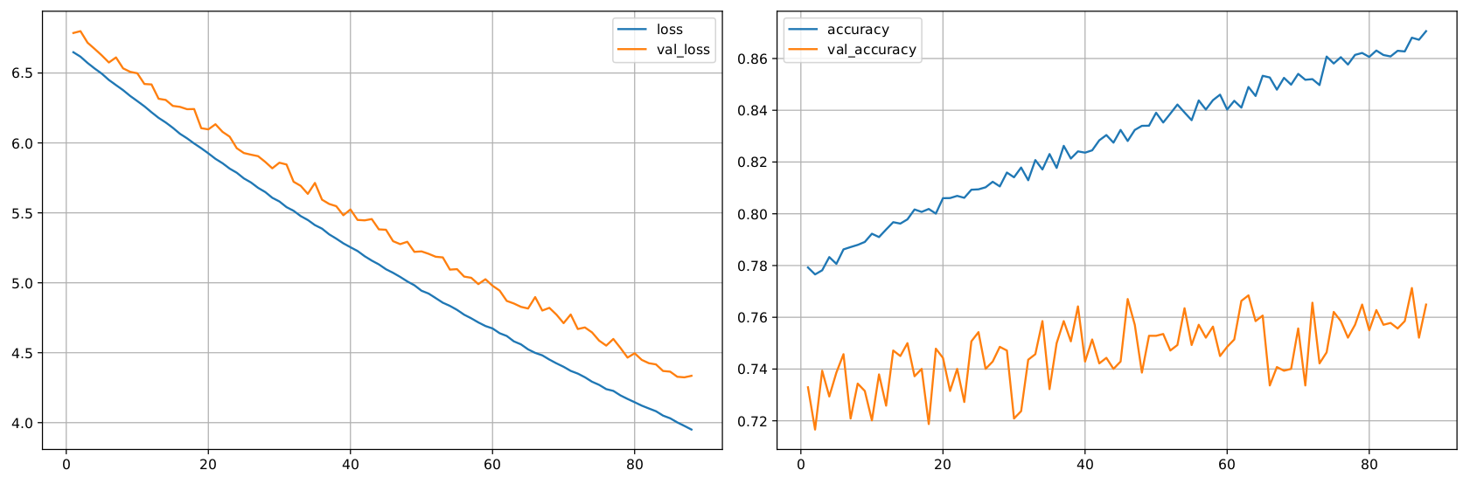
Results
ii Loss: 4.0019; Accuracy: 86.80%;
Validation loss: 4.3281; Validation accuracy: 77.13%

Slide 13
I’ve decided to continue learning from the augmentation part.
The best in my opinion options was to:
keep using data augmentation
unfroze layers layer by layer
Risks: not enough time to do both at the same time.
Solution:
I’ve decided to went in both directions (possibility to run two experiments in the same time):
Stay with data augmentation but unfroze all layers
Resign from data augmentation but unfroze layers in two steps.

Slide 14
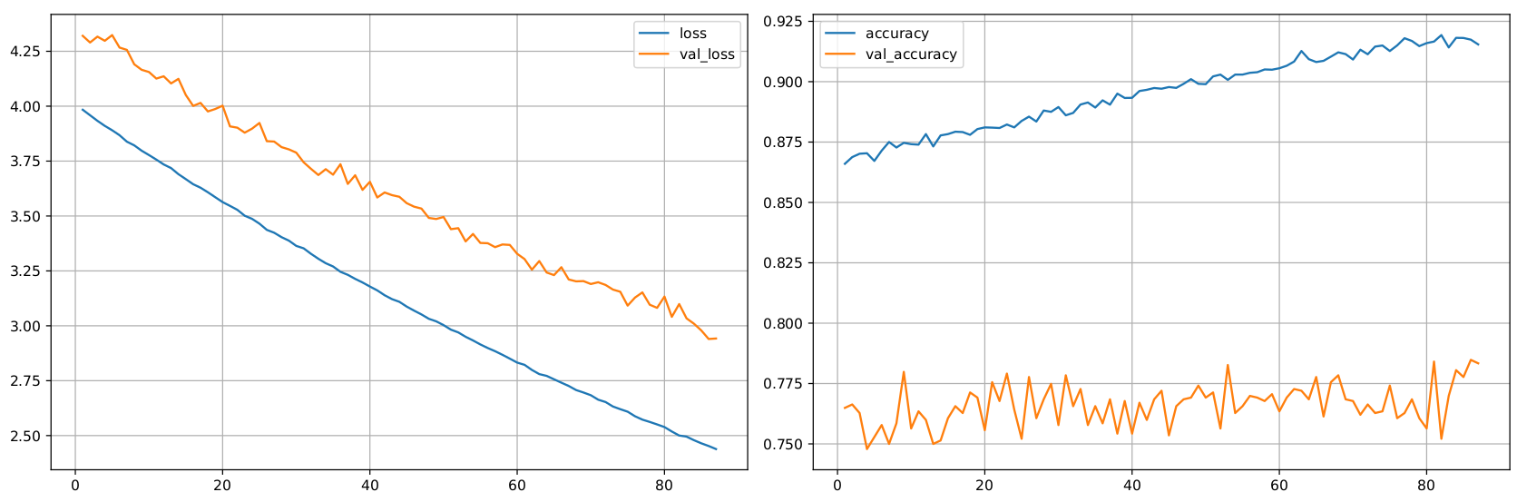
Stay with data augmentation but unfroze all layers (1)

Slide 15
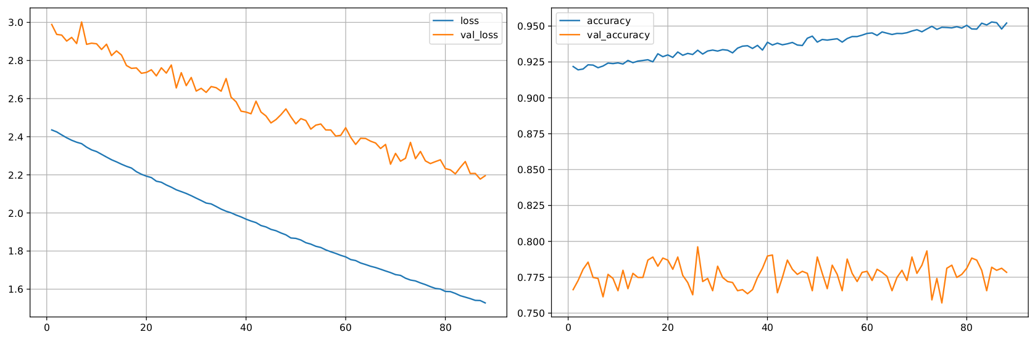
Stay with data augmentation but unfroze all layers (2)
Loss: 2.1214; Accuracy: 93.32%; Validation loss: 2.6561; Validation accuracy: 79.62%

Slide 16
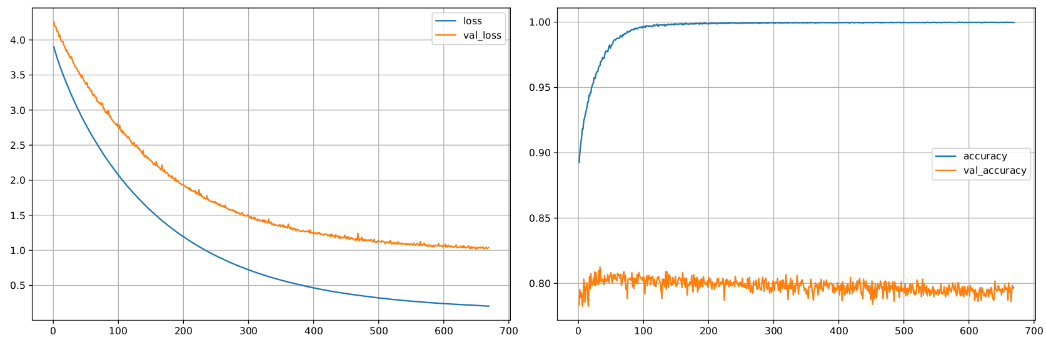
Resign from data augmentation but unfroze layers in two steps. (1)

Slide 17
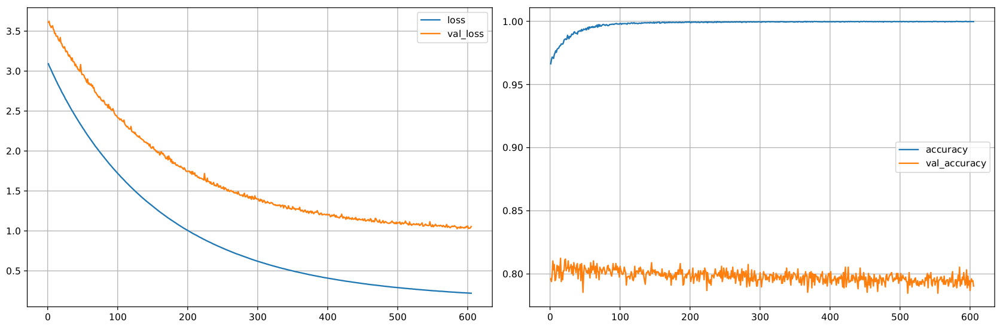
Resign from data augmentation but unfroze layers in two steps. (2)
Loss: 2.8288; Accuracy: 98.09%; Validation loss: 3.4019; Validation accuracy: 81.25%

Slide 18
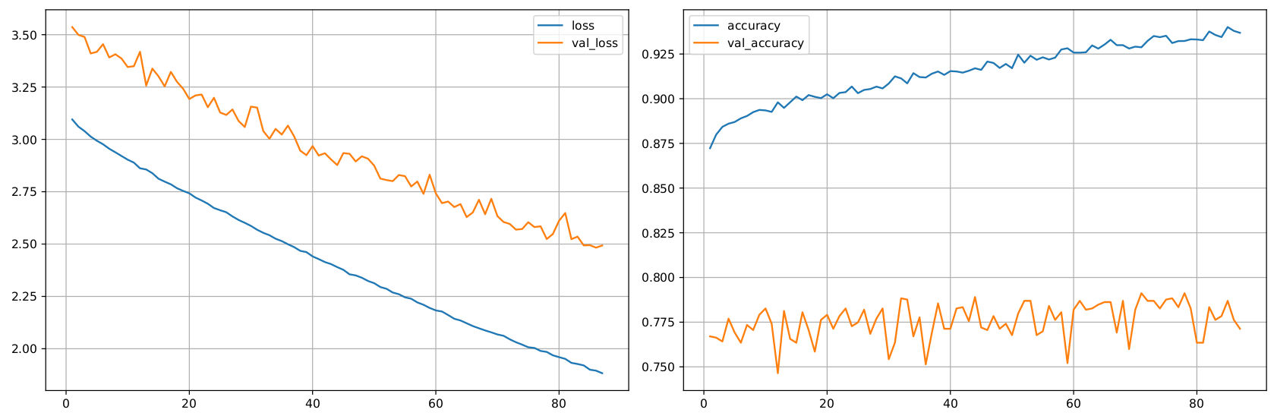
Resign from data augmentation but unfroze layers in two steps. (* After that, I wanted to see if training one time more but with augmentation will help)
Loss: 2.0618; Accuracy: 92.88%; Validation loss: 2.6053; Validation accuracy: 79.12%

Slide 19
Comparison of results
 | Loss | Accuracy | Val_loss | Val_accuracy
only dense layers no augmentation | 0.6381 | 99.92 | 1.3175 | 80.03
only dense layers augmentation | 4.0019 | 86.80 | 4.3281 | 77.13
augmentation all layers unfrozen | 2.1214 | 93.32 | 2.6561 | 79.62
no augmentation layers unfrozen steppedly | 2.8288 | 98.09 | 3.4019 | 81.25
no augmentation layers unfrozen steppedly one training with augmentation | 2.0618 | 92.88 | 2.6053 | 79.12

Slide 20
Feature extraction

Slide 21
Classificator choosing
Because of huge training time of SVM, Random Forest Classifier was chosen.

Slide 22
Layers to extract features from
'block1_conv1' 'block1_conv2'
'block2_conv1' 'block2_conv2'
'block3_conv1' 'block3_conv2', 'block3_conv3'
'block4_conv1' 'block4_conv2' 'block4_conv3'
'block5_conv1' 'block5_conv2' 'block5_conv3'
'fc1' 'fc2'
Number of features: 12416

Slide 23
Checked RFC paramthers
DEFAULT VALUES:
n_estimators = 100
min_samples_leaf = 2
RFC: min_samples_leaf = 20; n_estimators = 100
RFC: min_samples_leaf = 7; n_estimators = 100
RFC: min_samples_leaf = 2; n_estimators = 12
RFC: min_samples_leaf = 2; n_estimators = 50
with or without discretization

Slide 24
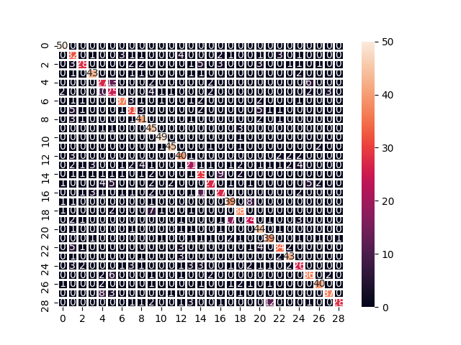
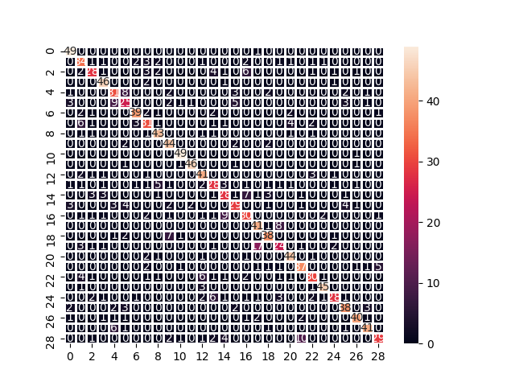
Results
min_samples_leaf = 2; n_estimators = 50
DISCRETIZATION
NO DISCRETIZATION
Accuracy: 71%
Accuracy: 73%

Slide 25
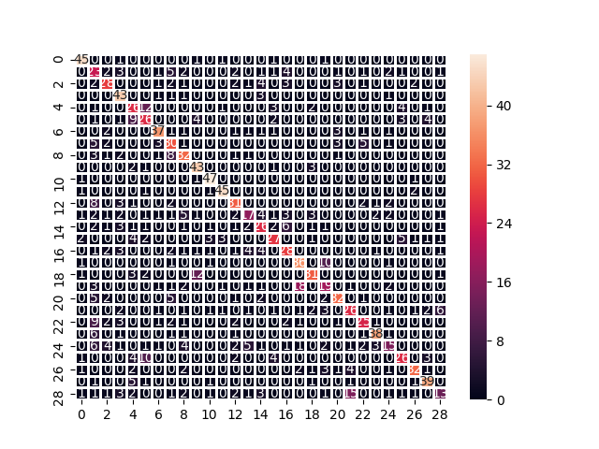

Results
min_samples_leaf = 2; n_estimators = 12
DISCRETIZATION
NO DISCRETIZATION
Accuracy: 61%
Accuracy: 63%

Slide 26


Results
min_samples_leaf = 20; n_estimators = 100
DISCRETIZATION
NO DISCRETIZATION
Accuracy: 67%
Accuracy: 69%

Slide 27
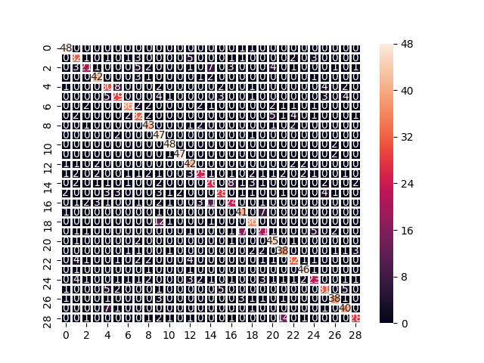
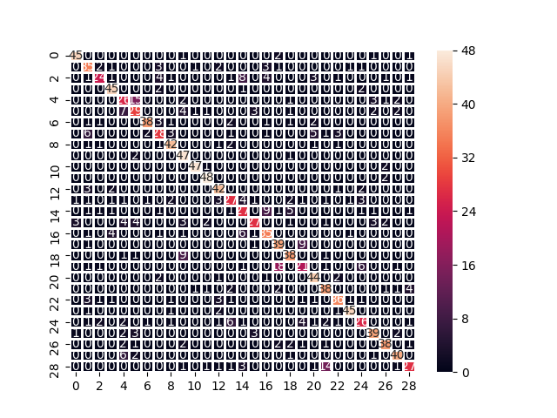
Results
min_samples_leaf = 7; n_estimators = 100
DISCRETIZATION
NO DISCRETIZATION
Accuracy: 70%
Accuracy: 72%

Slide 28
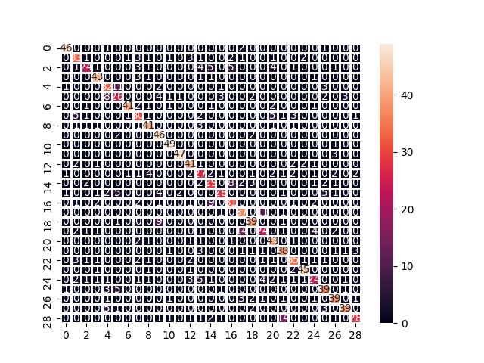
Combined experiment:
no discretization
n_estimators = 50
min_samples_leaf = 7
Accuracy: 72% (not the best one)
CONCLUSION:
The best model (acc = 73%):
no discretization
n_estimators = 50
min_samples_leaf = 2

Slide 29
Layers to extract features from
'block1_conv2'
'block2_conv2'
'block3_conv3'
'block4_conv3'
'block5_conv3'
Number of features: 1472

Slide 30
Checked RFC paramthers
ALL EXPERIMENTS WITHOUT DISCRETIZATION
RFC: min_samples_leaf = 20; n_estimators = 100
RFC: min_samples_leaf = 7; n_estimators = 100
RFC: min_samples_leaf = 2; n_estimators = 12
RFC: min_samples_leaf = 2; n_estimators = 50

Slide 31
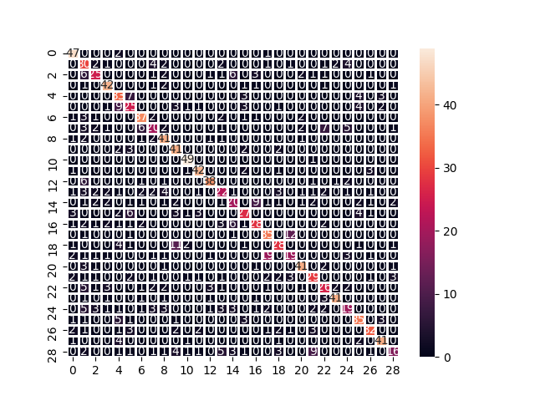
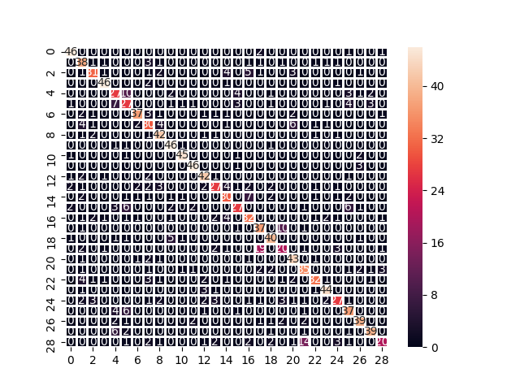
Results
min_samples_leaf = 2; n_estimators = 12
min_samples_leaf = 2; n_estimators = 50
Accuracy: 64%
Accuracy: 71%

Slide 32
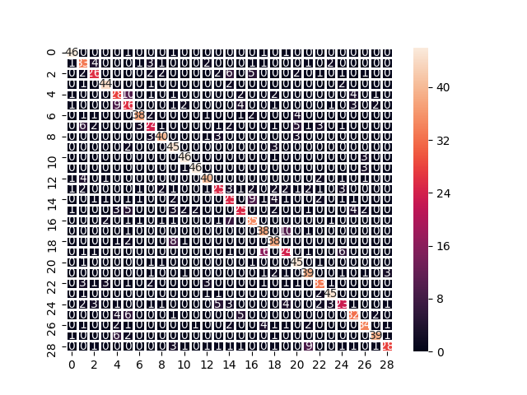
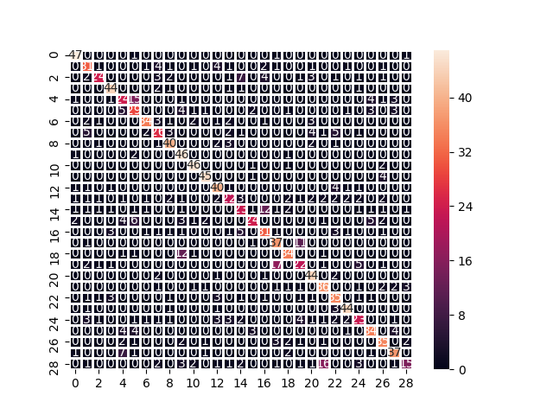
Results
min_samples_leaf = 7; n_estimators = 100
min_samples_leaf = 20; n_estimators = 100
Accuracy: 70%
Accuracy: 67%

Slide 33

Combined experiment:
n_estimators = 50
min_samples_leaf = 7
Accuracy: 70% (not the best one)
CONCLUSION:
The best model so far (acc = 73%):
features extracted from each layer
no discretization
n_estimators = 50
min_samples_leaf = 2

Slide 34
Single layer to extract features from
'block5_conv3'
Number of features: 512

Slide 35
Checked RFC paramthers
ALL EXPERIMENTS WITHOUT DISCRETIZATION
RFC: min_samples_leaf = 20; n_estimators = 100
RFC: min_samples_leaf = 7; n_estimators = 100
RFC: min_samples_leaf = 2; n_estimators = 12
RFC: min_samples_leaf = 2; n_estimators = 50

Slide 36
Results
min_samples_leaf = 2; n_estimators = 12
min_samples_leaf = 2; n_estimators = 50
Accuracy: 50%
Accuracy: 61%

Slide 37
Results
min_samples_leaf = 7; n_estimators = 100
min_samples_leaf = 20; n_estimators = 100
Accuracy: 61%
Accuracy: 59%

Slide 38
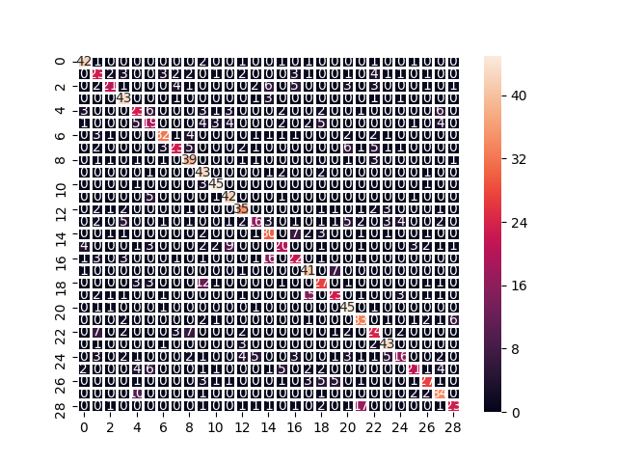
Combined experiment:
n_estimators = 50
min_samples_leaf = 7
val_ccuracy: 60% (not the best one)
CONCLUSION:
The best model so far (val_acc = 73%):
features extracted from each layer
no discretization
n_estimators = 50
min_samples_leaf = 2

Slide 39
Feature extraction from fine tuned model

Slide 40
Fine tuned model
 | Loss | Accuracy | Val_loss | Val_accuracy
only dense layers no augmentation | 0.6381 | 99.92 | 1.3175 | 80.03
only dense layers augmentation | 4.0019 | 86.80 | 4.3281 | 77.13
augmentation all layers unfrozen | 2.1214 | 93.32 | 2.6561 | 79.62
no augmentation layers unfrozen steppedly | 2.8288 | 98.09 | 3.4019 | 81.25
no augmentation layers unfrozen steppedly one training with augmentation | 2.0618 | 92.88 | 2.6053 | 79.12

Slide 41
Layers to extract features from
'block1_conv1' 'block1_conv2'
'block2_conv1' 'block2_conv2'
'block3_conv1' 'block3_conv2', 'block3_conv3'
'block4_conv1' 'block4_conv2' 'block4_conv3'
'block5_conv1' 'block5_conv2' 'block5_conv3'
'fc1' 'fc2' ‘fc3’
Number of features: 4224

Slide 42
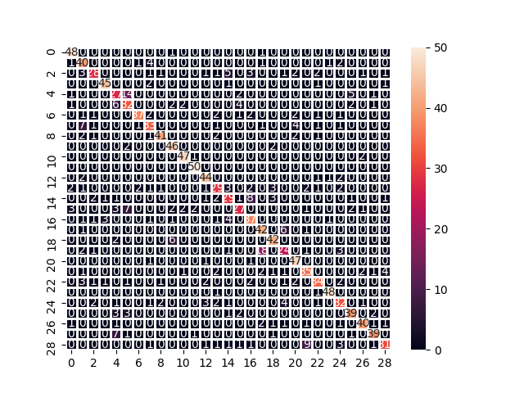
Better than on original VGG16
n_estimators = 50
min_samples_leaf = 2
Accuracy: 74%
better than the best one with features from original VGG16
(even with much smaller number of features)

Slide 43
Fine tuned model
 | Loss | Accuracy | Val_loss | Val_accuracy
only dense layers no augmentation | 0.6381 | 99.92 | 1.3175 | 80.03
only dense layers augmentation | 4.0019 | 86.80 | 4.3281 | 77.13
augmentation all layers unfrozen | 2.1214 | 93.32 | 2.6561 | 79.62
no augmentation layers unfrozen steppedly | 2.8288 | 98.09 | 3.4019 | 81.25
no augmentation layers unfrozen steppedly one training with augmentation | 2.0618 | 92.88 | 2.6053 | 79.12

Slide 44
Layers to extract features from
'block1_conv1' 'block1_conv2'
'block2_conv1' 'block2_conv2'
'block3_conv1' 'block3_conv2', 'block3_conv3'
'block4_conv1' 'block4_conv2' 'block4_conv3'
'block5_conv1' 'block5_conv2' 'block5_conv3'
'fc1' 'fc2' ‘fc3’
Number of features: 4224

Slide 45
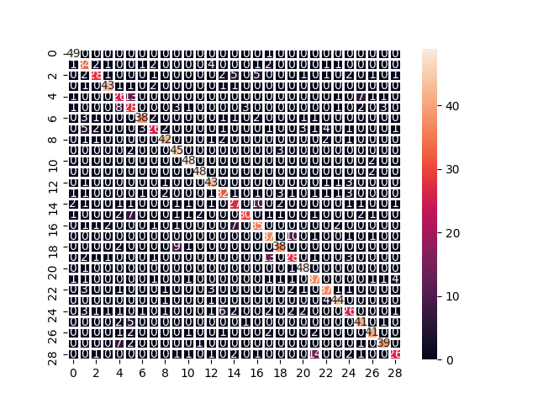
Combined experiment:
n_estimators = 50
min_samples_leaf = 2
Accuracy: 73%
CONCLUSION:
The best model so far (acc = 74%):
features extracted from each layer
no discretization
n_estimators = 50
min_samples_leaf = 2
based on fine tuned model

Slide 46
TESTING

Slide 47
The model with the best accuracy on validation dataset was chosen
Method | Description | Augmentation | Val_accuracy
fine tuning | trained in two steps: only dense layers (BN -> Dense(256) + L2 -> Dropout(0.4) -> Dense(256) + L2 -> Dense(256) + L2 -> Dense(29)) all neural network | YES | 79.62%
fine tuning | trained in three steps: only dense layers (BN -> Dense(256) + L2 -> Dropout(0.4) -> Dense(256) + L2 -> Dense(256) + L2 -> Dense(29)) dense layers + convolutional from block4 and block5 all neural network | NO | 81.25%
feature extraction | Features extracted from original VGG16 network, form all layers. Random forest model applied on these features without discretization. Random forest parameters: n_estimators = 50 min_samples_leaf = 2 | NO | 73%
feature extraction + fine tuning | Features extracted from fine tuned with augmentation VGG16 network, form all layers. Random forest model applied on these features without discretization. Random forest parameters: n_estimators = 50 min_samples_leaf = 2 | YES | 74%

Slide 48
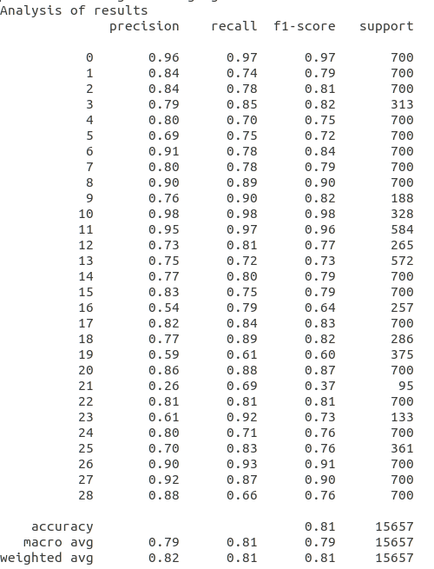
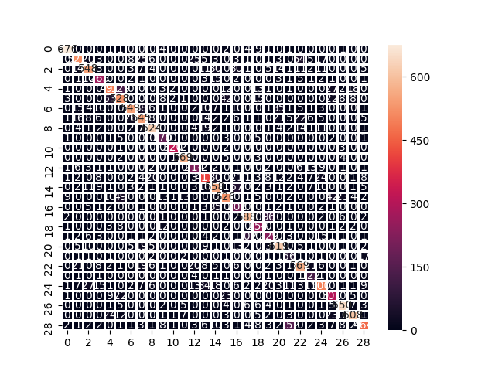
Performance of chosen model

